Slide 1

Designing a Sketch Recognition Front-End: User Perception of Interface Elements
Paul Wais • Aaron Wolin • Christine Alvarado
Harvey Mudd College
Department of Computer Science Sketchers Group
www.cs.hmc.edu
August 7th, 2007
Notes:
15

Slide 2
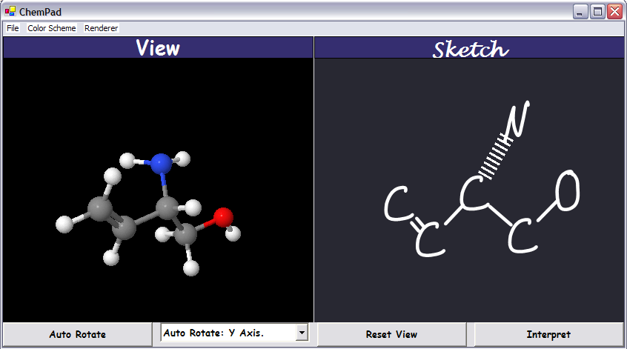
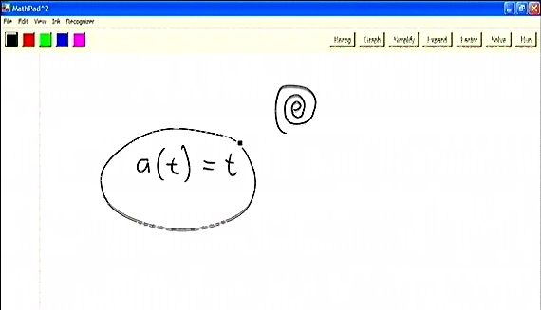
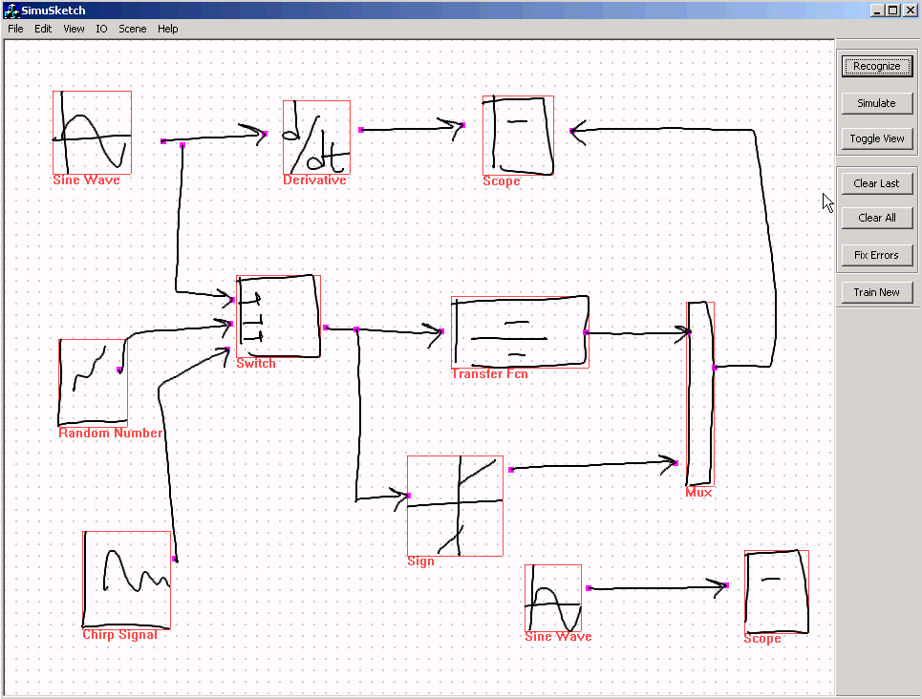
Sketch Recognition Simulation Systems
ChemPad, Dana Tenneson, et. al.
http://graphics.cs.brown.edu/research/chempad/home.html
MathPad², Joseph LaViola, Jr.
http://www.cs.brown.edu/~jjl/mathpad/
SimuSketch
Levent Burak Kara and Thomas F. Stahovich
http://www.engr.ucr.edu/~stahov/research/simusketch.htm
Notes:
30
Goals and what we want to investigate
Motivate recognition: talk about how our study does not address gesture- or menu-based recognition and how our users wanted the manually triggered recognition paradigm. Show how others address this paradigm in related work screenshots.
Chempad: gesture-based system (maybe not show it), SimuSkech=recognize button, SimuSketch=text+color feedback, (ACSparc=Color feedback), MathPad=annotation tool + gesture trigger
CHOICES CHOICES CHOICES!!

Slide 3
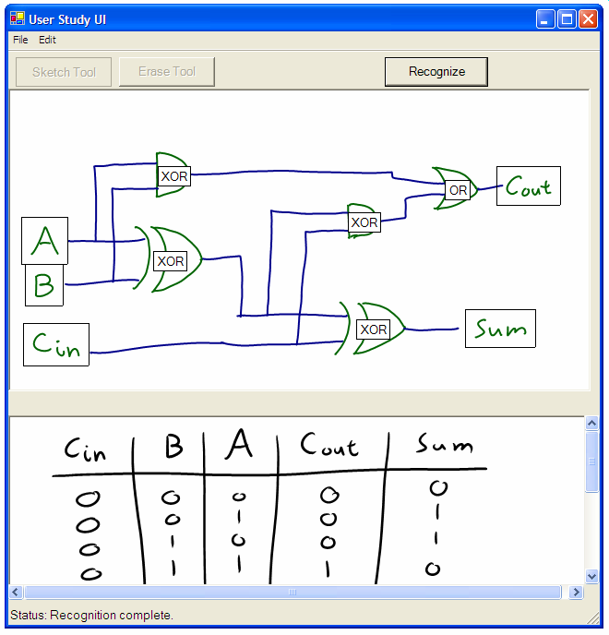
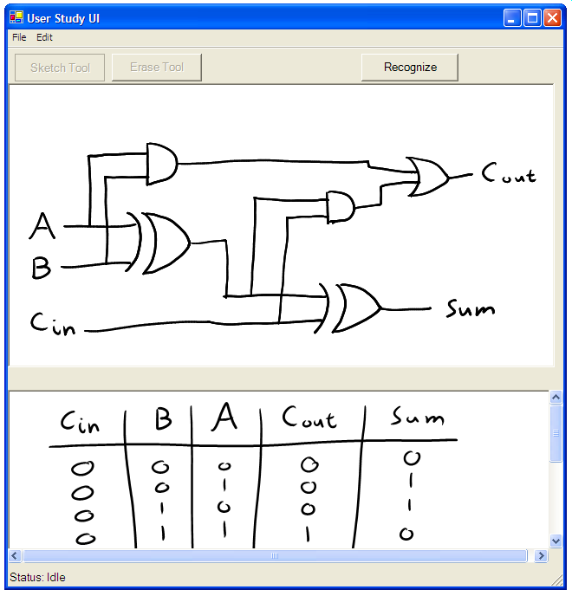
Goal: Investigate Sketch Recognition User Interface Issues
Recognition Triggers:
How should the user trigger recognition?
Separation Tools:
How should users separate recognized from unrecognized strokes, if at all?
Error Types:
How do recognition errors impact the user experience?
Feedback Mechanisms:
How should the recognition result be displayed?
Notes:
Mention digital design when entering into this slide; explain screenshot
We aim to directly compare several user interface choices that current sketch recognition systems employ. Building a recognizer engine is a challenge within itself; designing and evaluating an interface is an equal, and less well-understood challenge. Today, I will present a user study that investigates issues in sketch recognition interfaces in isolation from a working sketch recognition layer. Our contribution is to directly compare things people have tried. I will present preliminary results that suggest how user preferences may answer these questions.
User interface design of sketch recognition systems aims to make sketch recognition accessible and integrate sketch recognition into ordinary tasks
Though WIMP-based UI design is a well-explored problem, sketch recognition UI design is weakly understood.
End Goals of User Interface Design
Make non-traditional interaction with computers feel natural and intuitive
Maximize user satisfaction
Design a system that users accept
Disclaimer here: we are doing a preliminary study to examine user interface elements… initial results…

Slide 4
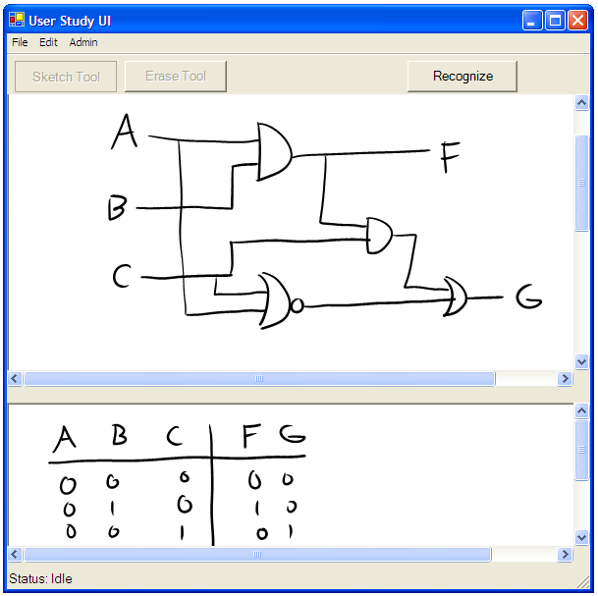
Context: Undergraduate Digital Design
User Domain: Undergraduate Engineering Students
  all had previous or concurrent enrollment in Introductory Digital Design course
  all had previous experience with Xilinx ISE, a mouse-and-keyboard CAD tool
Task T1
Please draw a circuit diagram for the following truth table:
Inputs |  |  | Outputs
A | B | C | F | G
0 | 0 | 0 | 0 | 0
0 | 0 | 1 | 1 | 0
0 | 1 | 0 | 0 | 1
0 | 1 | 1 | 0 | 0
1 | 0 | 0 | 0 | 0
1 | 0 | 1 | 0 | 0
1 | 1 | 0 | 0 | 1
1 | 1 | 1 | 0 | 0
Truth Table Task
Completed Circuit Diagram Drawn in UI

Slide 5
Experiment Structure
10 total interface elements tested:
  3 Recognition Triggers
  2 Separation Tools
  3 Types of Error
  2 Feedback Mechanisms
Feedback Mechanisms study:
  6 students, 45-75 minutes per student
  One truth table per type of feedback
  Human-simulated recognition (Wizard of Oz)
Prototype user interface used as a basis for all studies
Notes:
**we tested elements sequentially, only varying one trigger/error type etc across tests at a time**
Add mention of wizard of oz methodology?
I will now present select qualitative results from these studies

Slide 6

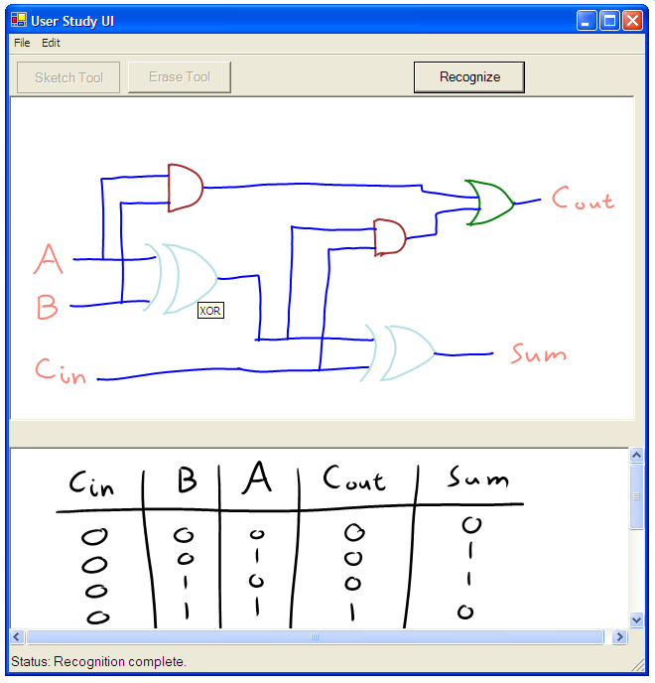
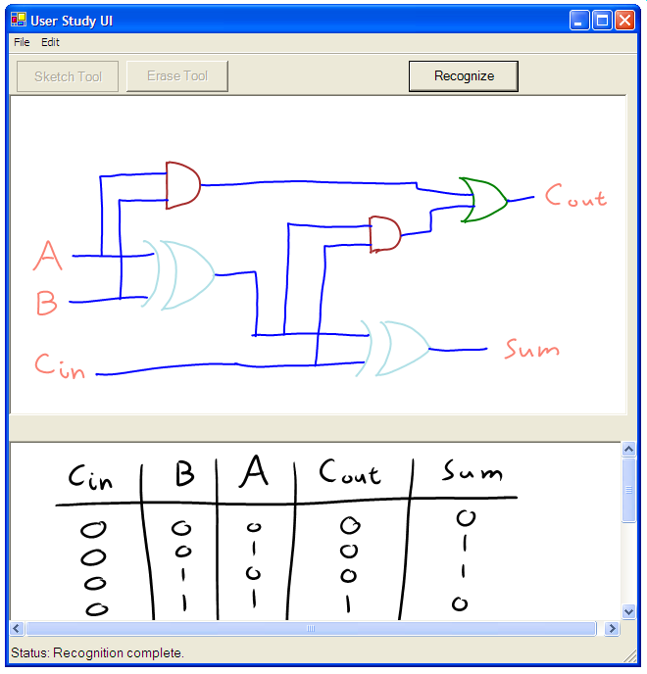
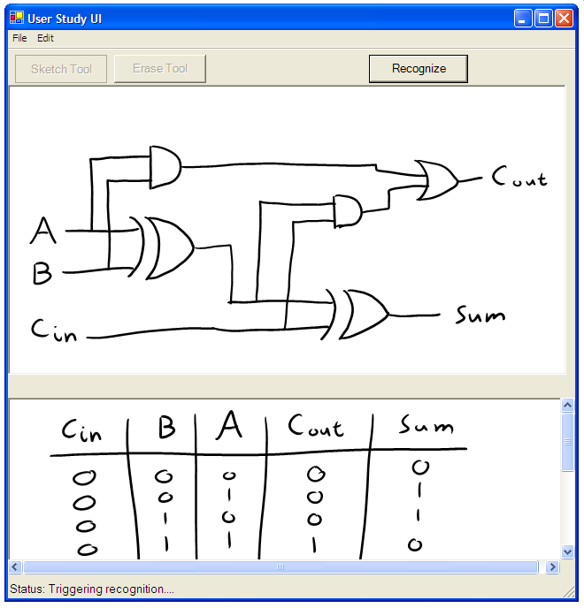
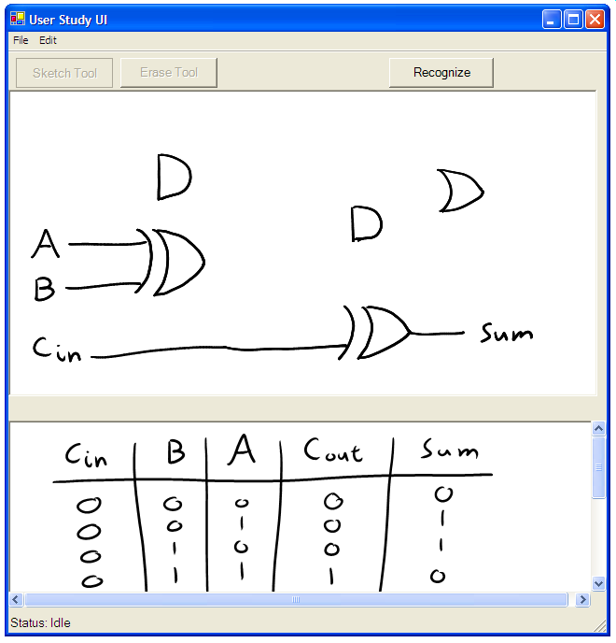
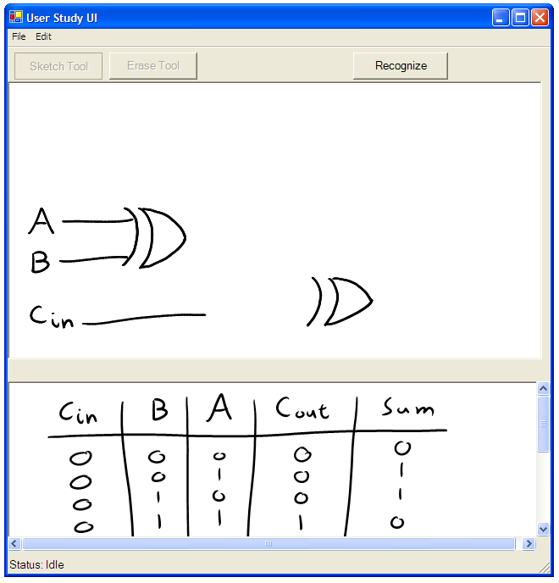
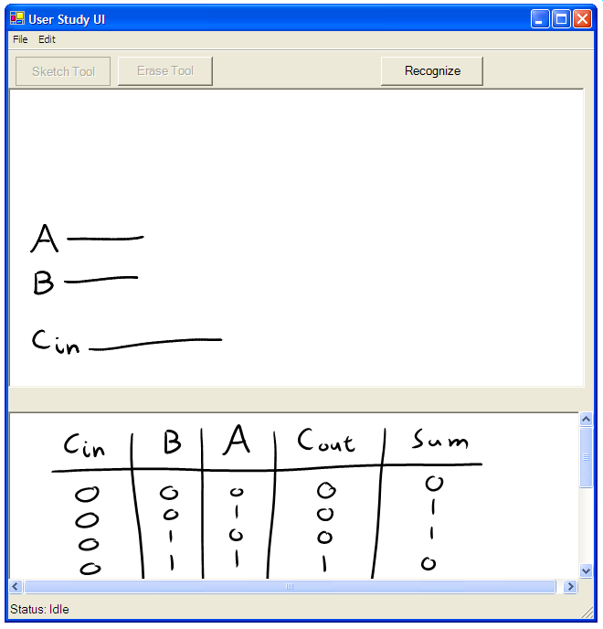
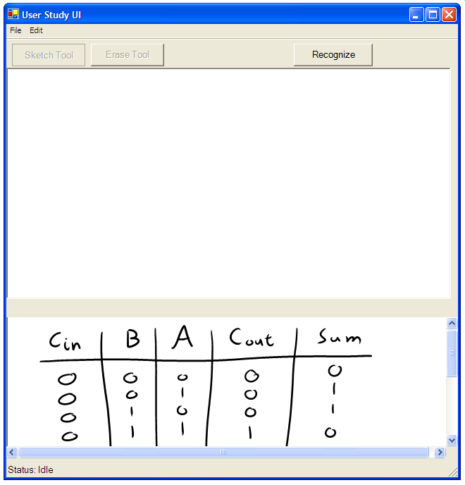
Feedback Mechanisms: Color versus Text
Color Feedback
Text Feedback
Notes:
Goals and what we want to investigate
The elements that support recognition: define them and describe how nobody has compared them before
Color feedback, where each type of symbol is color coded; and text label feedback, where symbols of interest are labeled with their names.

Slide 7
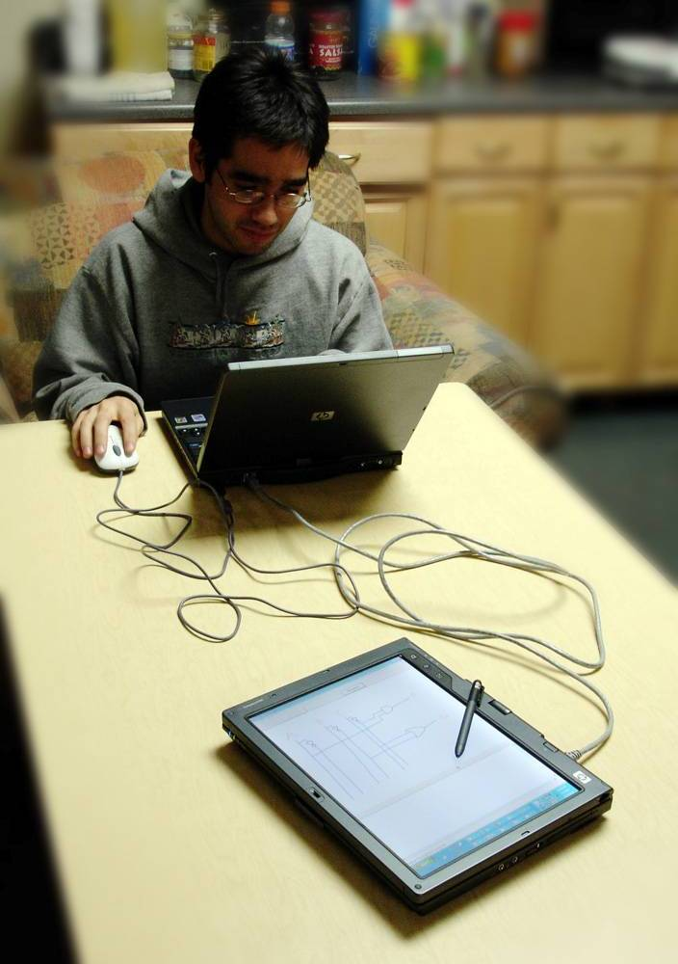
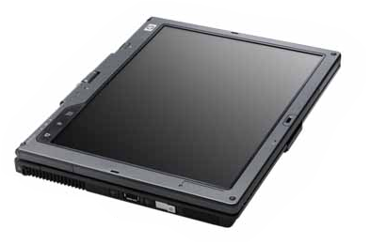
Wizard-Simulated Recognition and Error
Wizard Machine
Wizard Simulates
Recognition
Network
Connection
Wizard Receives
User Sketch
User Machine
User Draws Circuit
Simulated Recognition:
  Wizard provided recognition results (zero error rate) while testing Feedback Mechanisms
Simulated Error:
  Wizard-simulated grouping errors (~3-4 errors per sketch, equivalent to approx. 15% error rate)
  System-simulated mislabels and omissions (15% error rate)
Notes:
Woz: one sentence desc and compare to simulated error
Our Wizard of Oz approach consisted of having a human manually label and recognize user strokes whle the user worked on her own tablet. The user would then receive a labeled sketch from the wizard whenever she triggered recognition. In our previous study, we programmed the interface to apply labels randomly; here, a human labels sketches.

Slide 8
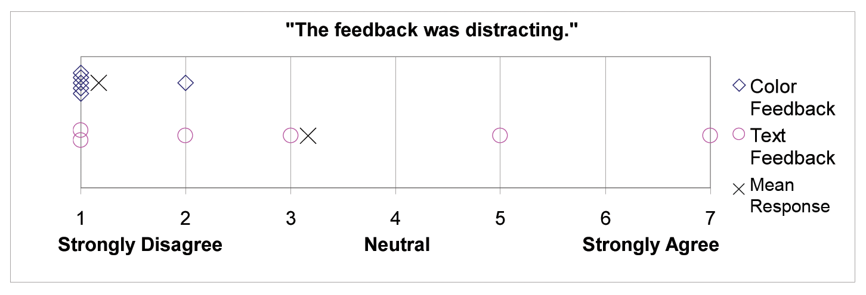
Results: Feedback Mechanisms
How should the recognition result be displayed?
Users prefer minimal transformation of their sketch
Users want minimal clutter and distraction
5 out of 6 users preferred Color Feedback
Users reported that Text Feedback was more distracting and produced clutter
Survey responses to “The feedback was distracting”
Notes:
(Show Truth Table results as well?)
“The text gets very cluttered [and] covers up the [sketch’s] points of interest quickly.”
One user comments color feedback is “more elegant” and “less redundant.”
Users unanimously find color feedback understandable, (7/7), but three of six users found text feedback 6/7 understandable.

Slide 9
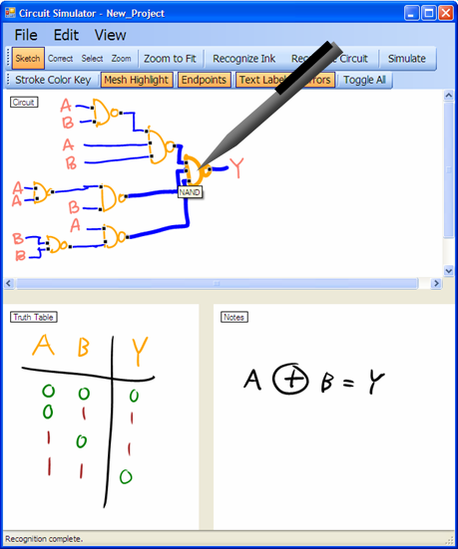
Conclusions
Feedback Mechanisms : should involve minimal visual transformation and not produce clutter
Recognition triggers : should be user-invoked, efficient, and reliable
Separation tools: Users should be able to separate recognized strokes from unrecognized strokes with an efficient pre-separation tool
Error Types: Users are willing to correct errors, but errors must be predictable and understandable
Sketchers Group Circuit
Simulator Application

